Slide 1
Advanced Business
Circulation Documenter

Slide 2
Implemented Functions
Transparency
Traceability
Anyone in the network
can see and verify the data
Anyone in the network
can trace the history of data
Immutability
Decentralization
If the system is well designed,
it’s hard to modify and exploit
Reliability can be maintained
even if there’s no
suitable intermediary agent

Slide 3
Implemented Functions
Transaction
Fundamental data storage
Merkle Root
Hash value of these TXs
Block Hash
Hash value with MR, Nonce, timestamp, etc
Previous Block’s Hash
Using like a linker in Linked List
Previous Block’s Hash
Nonce
Block hash
Merkle Root
TX1
TX2
TX3
…

Slide 4
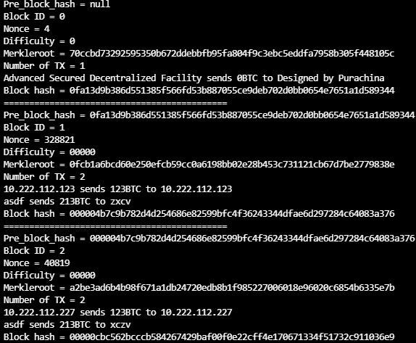
Implemented Functions
null
0fa13d9b3
0000004b7c
4
0fa13d9b3
328821
000004b7c
40819
00000cbc5
70ccbd732
0fcb1a6bc
a2be3ad6b
TX1
TX1
TX2
TX1
TX2

Slide 5

Implemented Functions
Hash
must
be
LESS
THAN
00100000
00000abcd
7
6
9
8
5
741852963
888777ccc
fffeeeddd
10
999123456
3
999000111
4
2
0
1
000ffffff
aaa333888
123987abc
987654321
abcdef012
aaabbbccc
Merkle Root
TX1
TX2
TX3
…
A
A’s Block Status
(PBH, MR, Timestamp, …)
String hash(Object o) {…}
000ffffff
10

Slide 6

Implemented Functions
B
B’s Block Status
(PBH, MR, Timestamp, …)
String hash(Object o) {…}
000ffffff
10
C
C’s Block Status
(PBH, MR, Timestamp, …)
String hash(Object o) {…}
000ffffff
10

Slide 7
Implemented Functions
00000abcd
000ffffff
10
0
000ffffff
0
fed987002
3
999aaafff
4
2
5
999000111
0
1
aaa333888
123987abc
987654321
abcdef012
aaabbbccc
Merkle Root
123456789
abcdef123
TX1
TX2
TX3
…
TX1
TX2

Slide 8
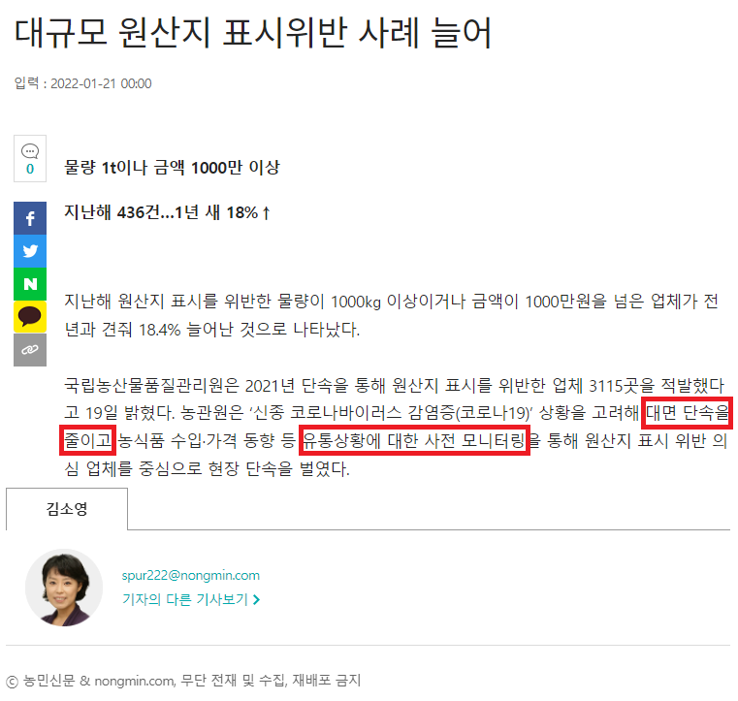
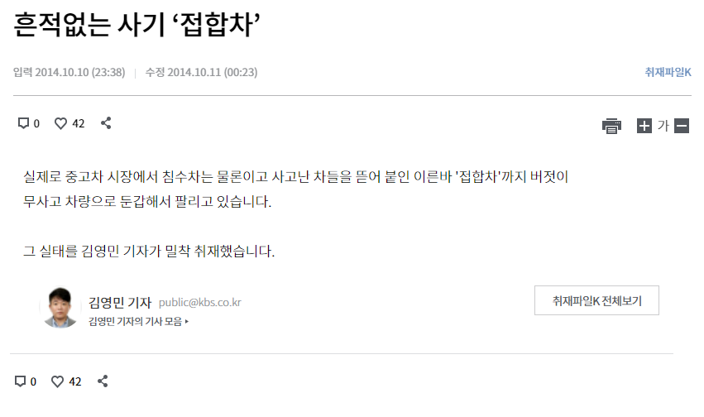
Implemented Functions

Slide 9
Implemented Functions
Good
Bad
Have little advantage to cheating
Considering Brand value, Justification
Easy to monitor
Often happens in B2C
One-time transaction that difficult to build reliability
Difficulty to control because there’re many small point

Slide 10
Implemented Functions
Good
123456789
abcdef012
123456789
aaabbbccc
abcdef012
123456789
aaabbbccc
000111222
abcdef012
123456789
aaabbbccc
000123456
abcdef012
aaabbbccc
000987654
000abcdef
abcdef012

Slide 11

Implemented Functions
Hash value
invalid!!!
aaabbbccc
Made in Korea
Made in China
Good
123456789
abcdef012
123456789
aaabbbccc
000111222
abcdef012
123456789
aaabbbccc
000123456
abcdef012
aaabbbccc
000987654
000abcdef

Slide 12
Implemented Functions
Manipulated N
PBH
invalid!!!
000111222
Made in Korea
Good
123456789
abcdef012
123456789
aaabbbccc
abcdef012
123456789
aaabbbccc
000123456
abcdef012
aaabbbccc
000987654
000abcdef
000333444

Slide 13


Implemented Functions
! ! !
Prod date
20220302
Repair: 0
Prod date
20210404
Repair: 0
Prod date
20210404
Repair: 0

Slide 14

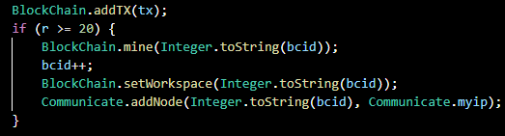
Simulating the Real-World
Door 2 BlockChain
Door 1 BlockChain
cccddd
000fff
aaabbb
123456
987654
abcdef
Door ID: 2
Door ID: 1
TX
TX

Slide 15
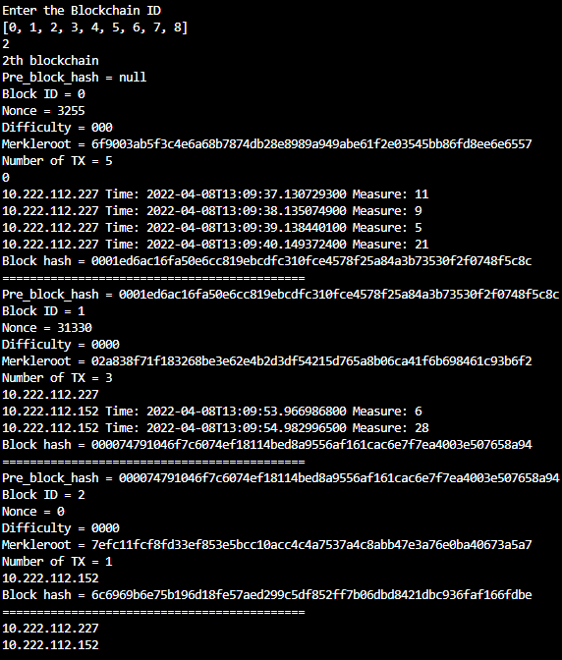
Simulating the Real-World
Door ID: 1
Block which contains
Manufacturer’s TX
Requests Door 1’s BlockChain
Door 1 BlockChain
000123
000fff
aaabbb
000123
123456
aaabbb
987654
abcdef
cccddd
fff123
cccddd
fff123
TX
TX
TX
TX

Slide 16
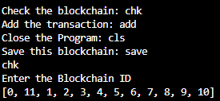
Element-wise Hashing
Basically,
Manufacturer has
all the BlockChains
In this model
Door 1 Network
Door 2 Network
000fff
000123
123456
987654
abcdef
aaabbb
cccddd
fff123
000aaa
999852
TX
TX
TX
TX
TX

Slide 17
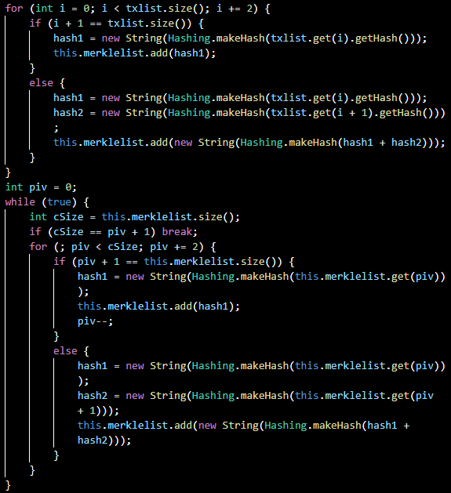
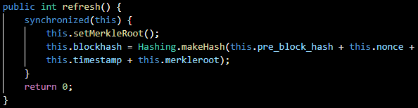
Element-wise Hashing
Make Merkle Tree
Re-Hashing Entire Block when TX added

Slide 18
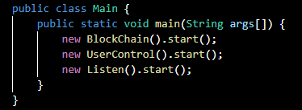
Main Functional Threads
BlockChain
For Initializing Mining, Distributing, Applying Block, etc
UserControl
For Scanning User Input (It may become a value reader)
Listen
For receiving the Other Node’s Request and Answer it

Slide 19
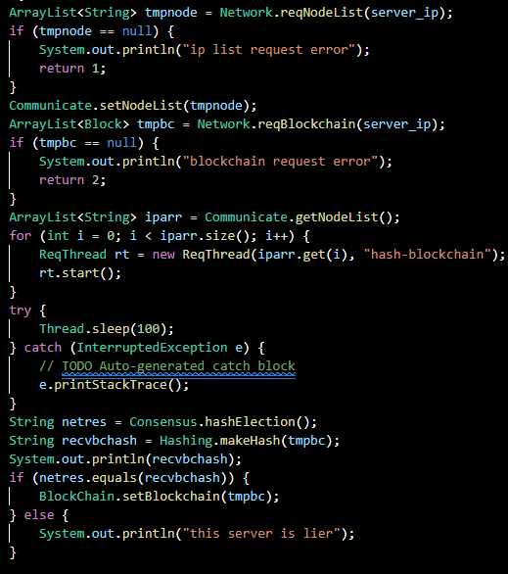
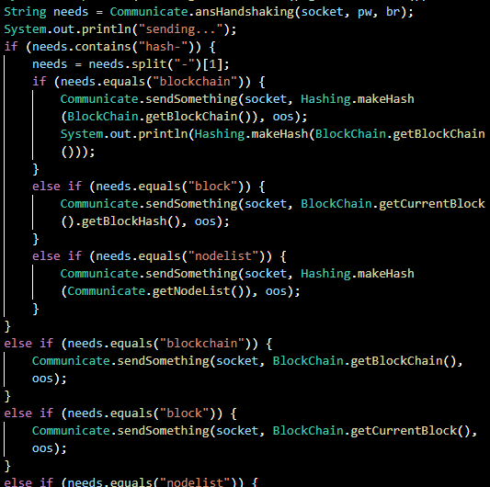
Codes for Initializing and Server
Request BlockChain and Validate

Slide 20
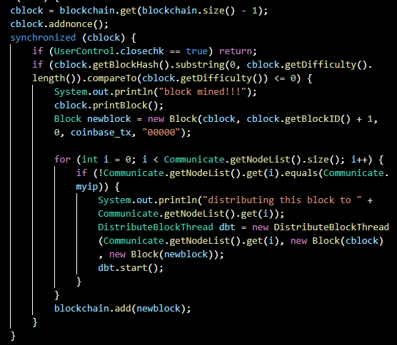
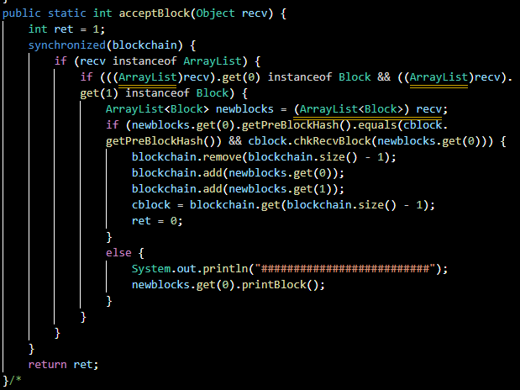
Codes for Mining and Distribution/Receiving
(with validation)

Slide 21
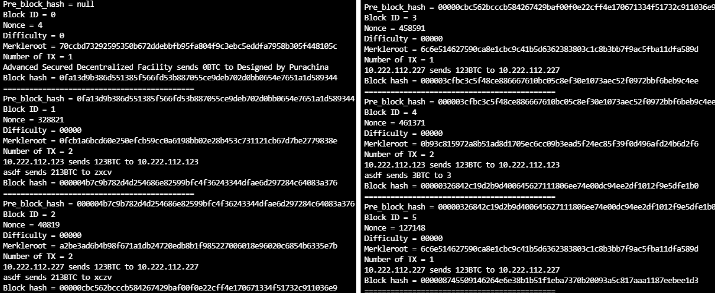
Operating Screen

Slide 22
Problems and Milestones
P2P Network with 3 or more Nodes
Because of Resource Sharing
Model Applying
How to Detail and Apply
Optimization
Separating Codes for Maintainability
Adding More Plausible Functions
Webpage for Introduction, Smart Contracts, More Consensus Algorithms

